Slide 1
Al-based Generative design of Hydropower plants.
CSE7101- Capstone Project
Review-4
Batch Number: CCS_34
Under the Supervision of,
Dr. Sridevi S
School of Computer Science and Engineering
Presidency University
Roll Number | Student Name
20221CCS0067 | Aashrith.K
20221CCS0105 | P Harsha
20221CCS0106 | Narayana A
Name of the Program: B.Tech Computer Science and Engineering ( Cyber Security)
Name of the HoD: Dr. Anandaraj S.P
Name of the Program Project Coordinator: Dr. Sharmasth Vali
Name of the School Project Coordinators: Dr. Sampath A K , Dr. Geetha A

Slide 2
Content
Introduction
Literature Survey
Problem Statement
System Model
Result
Conclusion
References

Slide 3
Introduction
Hydropower remains one of the most reliable and sustainable sources of renewable energy. However, the traditional design process for hydropower components—such as turbines, generators, intake structures, and dam layouts—is often complex, time-consuming, and highly dependent on manual modeling.
This project introduces an AI-driven generative design system that automates the creation of hydropower plant components using:
Python-based parametric modeling
Blender for 3D geometry generation
OpenAI Whisper for voice-based interaction
A custom graphical user interface (GUI) for parameter entry
The system allows engineers to provide input parameters (dimensions, site conditions, design constraints) through text or voice, and automatically generates accurate, customizable 3D models within seconds.
This significantly reduces design time, minimizes human error, and enhances engineering productivity.
The project ultimately aims to function as an intelligent design assistant, supporting rapid prototyping, visualization, and optimization of hydropower infrastructure.

Slide 4
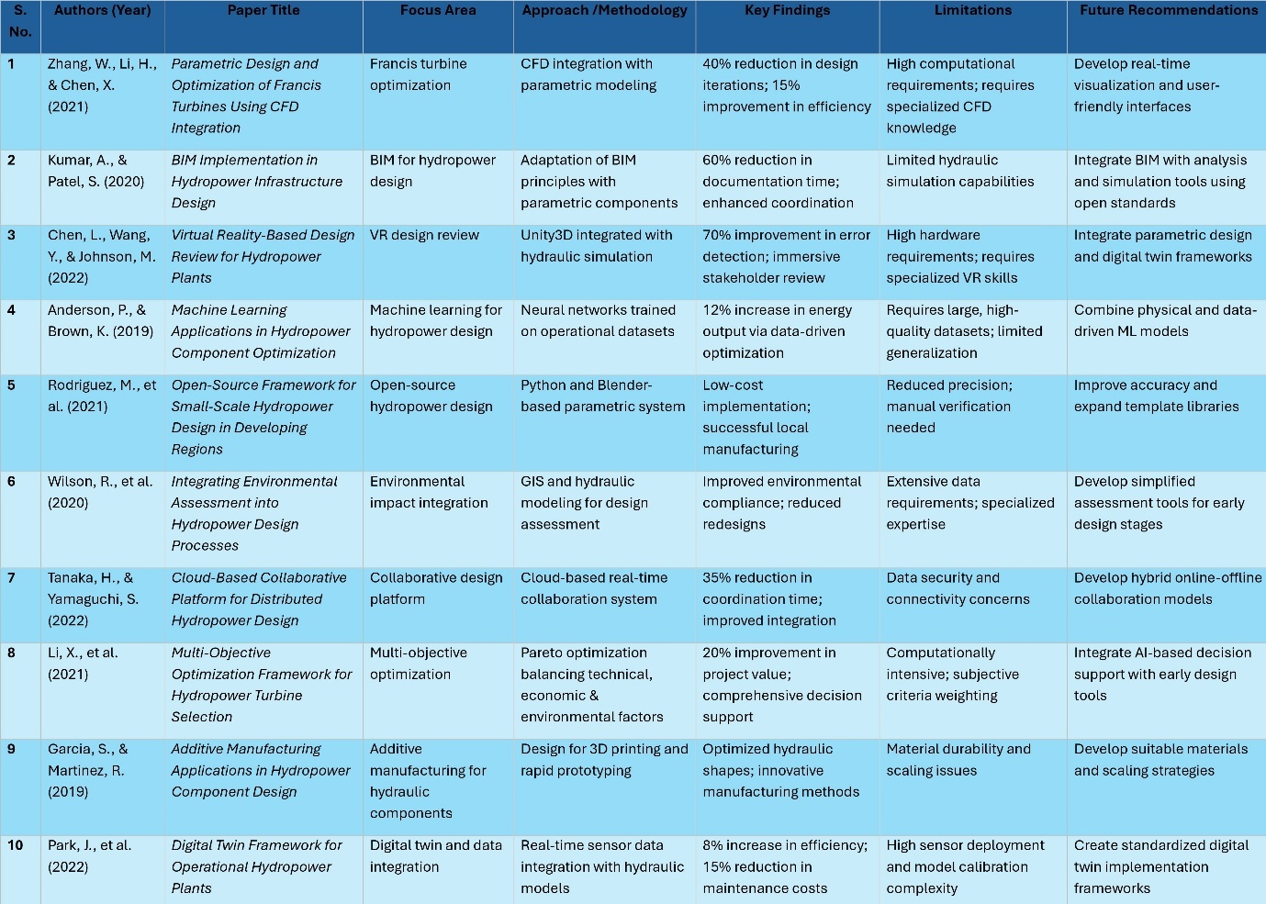
Literature Survey

Slide 5
Problem Statement Number: PSCS_11
Category : Software Based Project
Problem Description:
The proposed system focuses on AI-based Generative Design of Hydropower Plants, integrating civil structures, hydro-mechanical, and electro-mechanical equipment into an automated design workflow. The core idea is to leverage Blender software in combination with Python programming to create intelligent, parameter-driven 3D models of hydropower plant components.
Users will be able to provide inputs either through keyboard entry or via a voice assistant interface powered by OpenAI Whisper. These inputs, which may include specifications such as dimensions, capacity requirements, or site-specific constraints, will be processed to dynamically generate or adapt pre-loaded templates within Blender. The result is a customized 3D model that meets the client’s requirements with high accuracy and efficiency.
By automating the generative design process, this project eliminates repetitive manual modeling, accelerates the design cycle, and reduces the possibility of human error. It also provides scope for AI-driven optimization, where design variations can be evaluated for performance, sustainability, and cost-effectiveness. Ultimately, this system will serve as a smart design assistant for engineers and planners, enabling rapid prototyping and visualization of hydropower infrastructure.

Slide 6
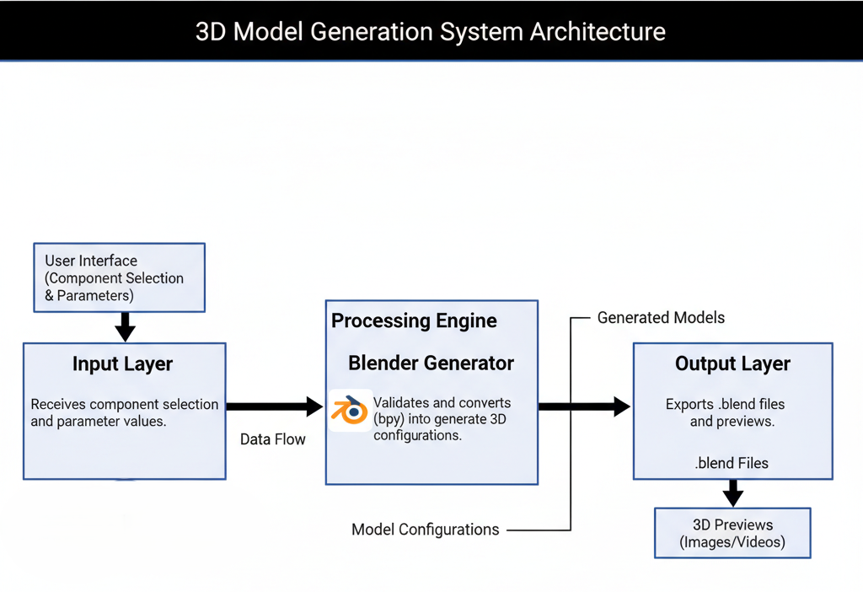
System Model
Description :
The process begins when the user inputs design parameters through the UI. These parameters are passed to the Core Processing Layer, which validates the input and prepares a JSON configuration file. The configuration is fed into the Blender Integration Engine, where parametric modeling scripts construct the 3D geometry.
Blocks Description:
Input Layer: Receives component selection and parameter values.
Processing Engine: Validates and converts data into model configurations.
Blender Generator: Uses Python (bpy) to generate the actual 3D models.
Output Layer: Exports .blend files and previews.
This modular approach ensures reusability and easy integration of new hydropower components.
Fig. 5.1 represents the high-level architecture of the hydropower design system.

Slide 7
Result

Slide 8
Result

Slide 9
Conclusion
The system successfully automates hydropower component design using a powerful blend of parametric modeling, AI-driven validation, and Blender automation.
It significantly reduces design time while improving accuracy, consistency, and user accessibility.The modular architecture makes the tool scalable for future enhancements, including CFD/FEA integration and cloud-based collaboration.
Overall, the project demonstrates how intelligent design automation can accelerate engineering workflows and support sustainable hydropower development.

Slide 10
References
[1] Zhang, W., Li, H. and Chen, X., 2021. Parametric Design and Optimization of Francis Turbines Using CFD Integration. Journal of Hydraulic Engineering, 147(3), pp.234-245.
[2] Kumar, A. and Patel, S., 2020. BIM Implementation in Hydropower Infrastructure Design. Automation in Construction, 118, pp.103-115.
[3] Chen, L., Wang, Y. and Johnson, M., 2022. Virtual Reality-Based Design Review for Hydropower Plants. Advanced Engineering Informatics, 52, pp.101-112.
[4] Anderson, P. and Brown, K., 2019. Machine Learning Applications in Hydropower Component Optimization. Renewable Energy, 143, pp.345-356.
[5] Rodriguez, M., Silva, P. and Gonzalez, R., 2021. Open-Source Framework for Small-Scale Hydropower Design in Developing Regions. Energy for Sustainable Development, 62, pp.78-89.
[6] Wilson, R., Thompson, K. and Lee, S., 2020. Integrating Environmental Assessment into Hydropower Design Processes. Journal of Environmental Management, 275, pp.111-123.
[7] Tanaka, H. and Yamaguchi, S., 2022. Cloud-Based Collaborative Platform for Distributed Hydropower Design. Computer-Aided Design, 145, pp.134-145.
[8] Li, X., Wang, Z. and Zhang, Y., 2021. Multi-Objective Optimization Framework for Hydropower Turbine Selection. Applied Energy, 298, pp.234-246.
[9] Garcia, S. and Martinez, R., 2019. Additive Manufacturing Applications in Hydropower Component Design. Additive Manufacturing, 28, pp.67-78.
[10] Park, J., Kim, S. and Lee, H., 2022. Digital Twin Framework for Operational Hydropower Plants. IEEE Transactions on Sustainable Energy, 13(2), pp.456-467.

Slide 11
Github Link
The Github link provided should have public access permission.
Github Link :
https://github.com/aashrith2204/Al-based-Generative-design-of-Hydropower-plants..git

Slide 12
Timeline of the Project (Gantt Chart)
Activity | Start Date | End Date | Deliverable / Focus
Review-1 (CA-01) | 13-08-2025 | 20-08-2025 | 📊 Project Proposal & PPT Presentation (Problem statement, objectives, methodology, tech stack)
Review-2 (CA-02) | 03-09-2025 | 10-09-2025 | 🏗️ Basic Models & Initial Designs (Civil structures draft models in Blender, Python integration demo)
Review-3 (CA-03) | 23-09-2025 | 26-09-2025 | ⚙️ Prototype Demonstration (Generative design workflow, AI-assisted model generation, voice/keyboard input integration)
Review-4 (CA-04) | 28-10-2025 | 31-10-2025 | 🚀 Advanced Models & Optimization (Hydro-mechanical & electro-mechanical components, improved automation, optimization results)
Final Viva (CA-05) | 17-11-2025 | 21-11-2025 | 🎯 Complete System Demonstration & Report Submission (End-to-end working demo, final PPT, documentation)

Slide 13


